Slide 1
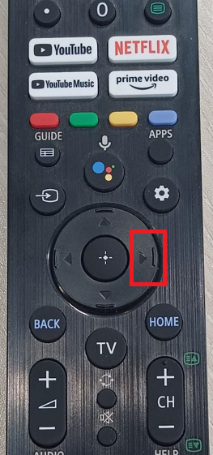
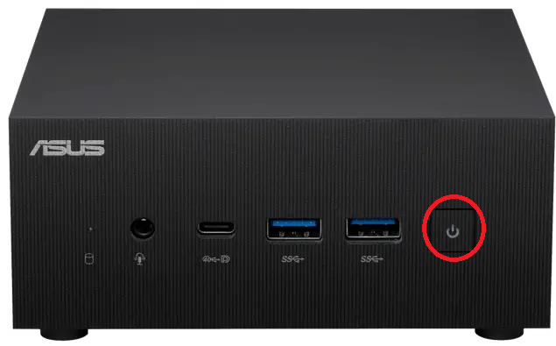
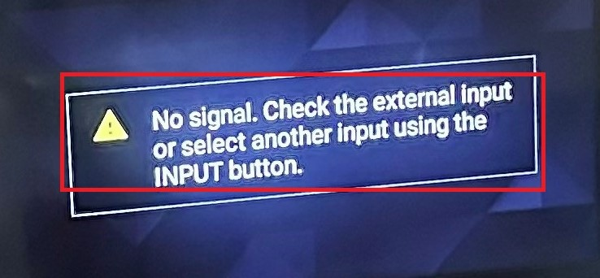

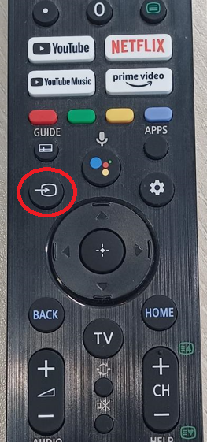
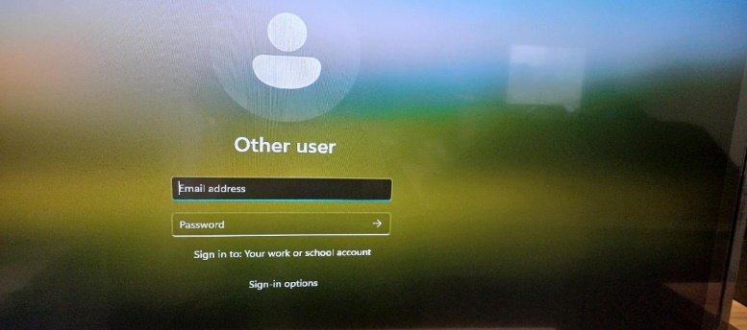
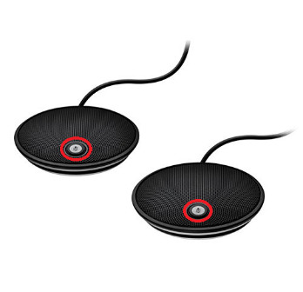
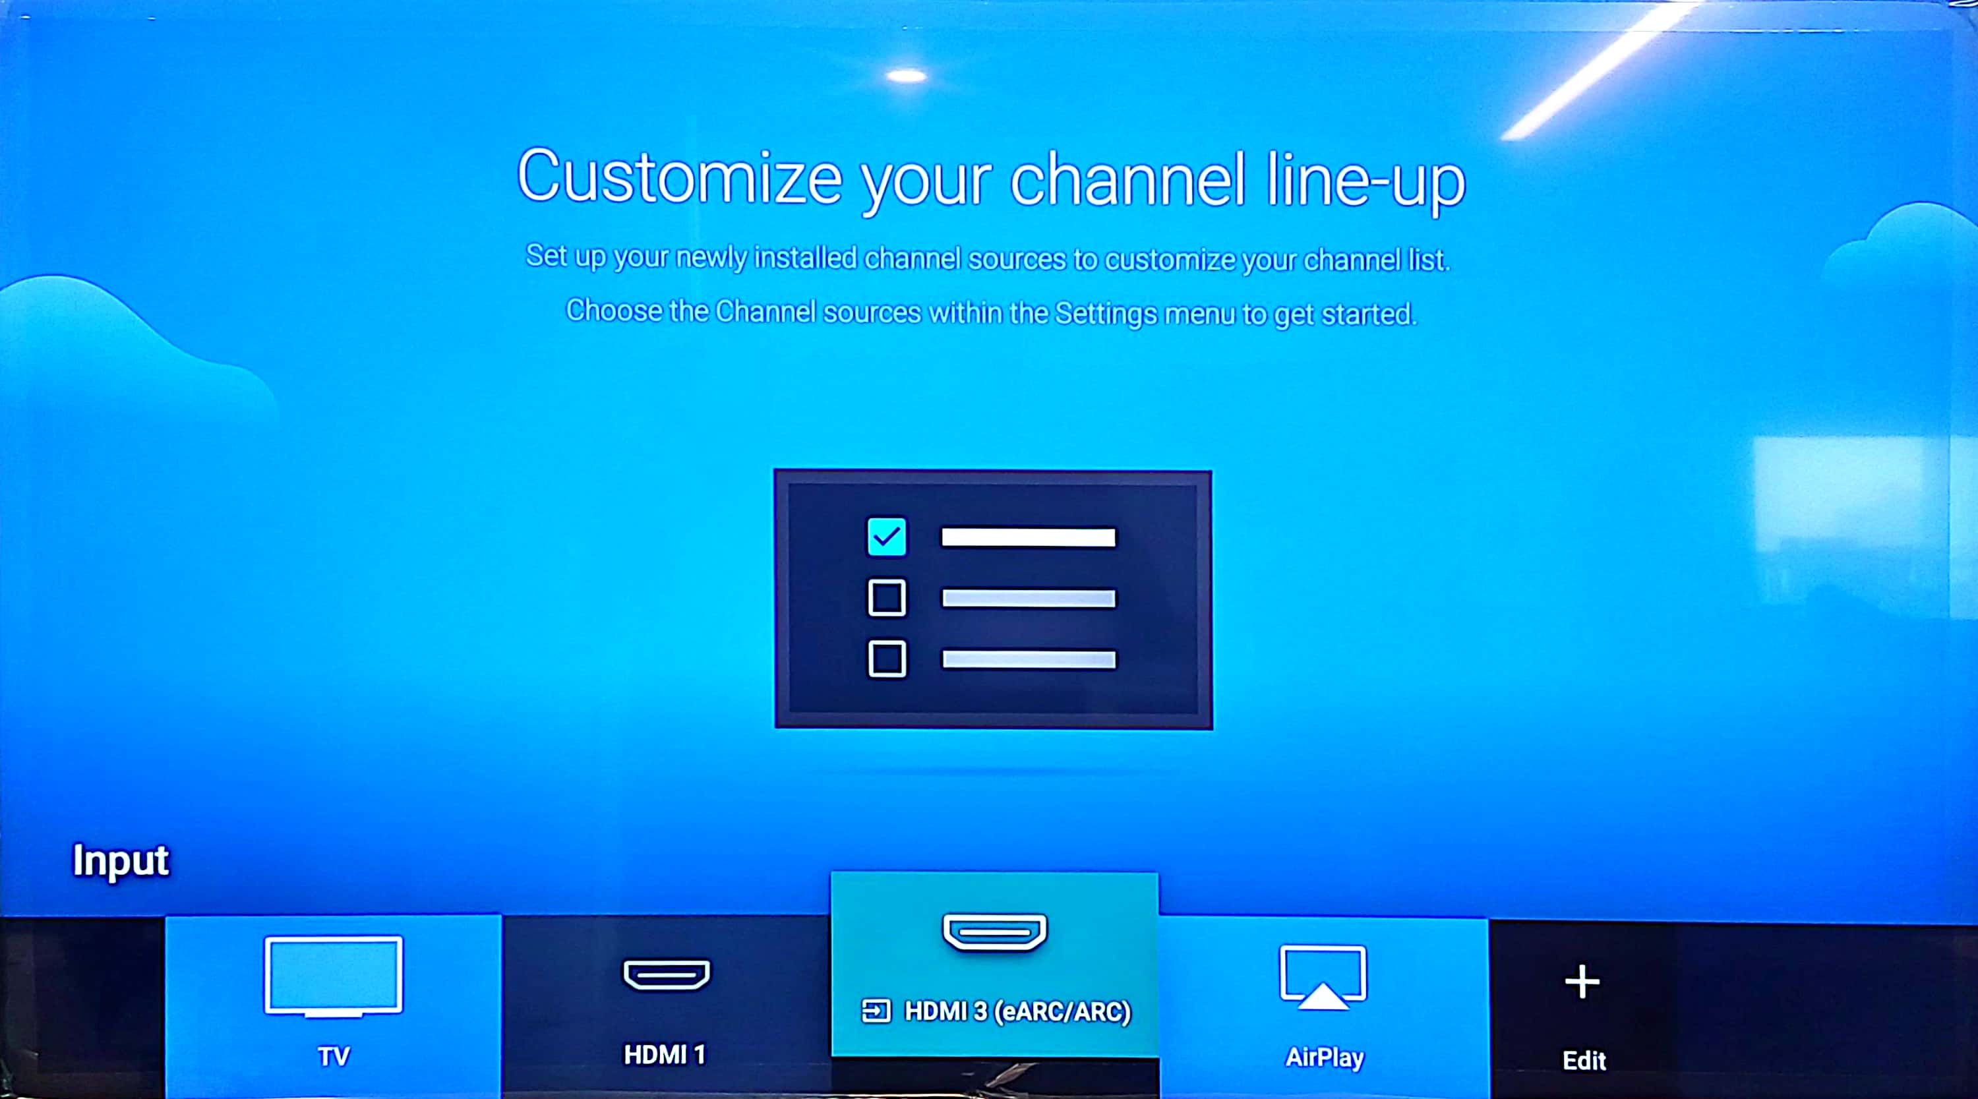
Meeting Room Setup Pictorial Document
1. Press the power button to turn on the Mini-PC.
5. To select the HDMI 3 option, use the right arrow on the remote.
2. After powering on, look at the TV for the display. If the TV displays No signal error message,
6. You will get the Mini-PC login screen. Then, log in to this PC by clicking on the 'Other User' option.
7. Use your RSC email address and password to log in to this PC.
3. Then press the input button on the TV remote.
8. To mute/unmute the microphone, please click this button.
4. And select the HDMI 3 option.
9. Instead of a Mini-PC, if you are using a personal laptop, just connect the HDMI cable and follow Step-3 and Step-4.

